Slide 1
Loan Approval Prediction Using Machine Learning
Data Handling and visualization
Project
Review 1

Slide 2
Problem Statement
LOANS are the major requirement of the modern world. By this only, Banks get a major part of the total profit. It is beneficial for students to manage their education and living expenses, and for people to buy any kind of luxury like houses, cars, etc.
But when it comes to deciding whether the applicant’s profile is relevant to be granted with loan or not. Banks have to look after many aspects.

Slide 3
Objective
So, here we will be using Machine Learning with Python to ease their work and predict whether the candidate’s profile is relevant or not using key features like Marital Status, Education, Applicant Income, Credit History, etc.

Slide 4
Features Used in Loan Approval Prediction
Marital status
Education
Credit history
LoanAmount
Credit_History
Property_Area
ApplicantIncome

Slide 5
Machine Learning Model
A Random Forest Classifier :an ensemble learning method that combines the predictions of multiple decision trees. Each tree is built on a random subset of features and data points, creating a diverse "forest" of decision-making trees.
Logistic Regression: A simpler model that works well for binary classification tasks like loan approval (approved/rejected).
Support Vector Machines (SVM): Effective for high-dimensional data and can handle non-linear relationships.
KNeighboursClassifiers: KNeighborsClassifiers are a type of machine learning model that classifies data points based on the proximity of their neighbors in the feature space. They can be effective for loan approval prediction, especially for data with well-defined clusters.

Slide 6
Colab Link

Slide 7
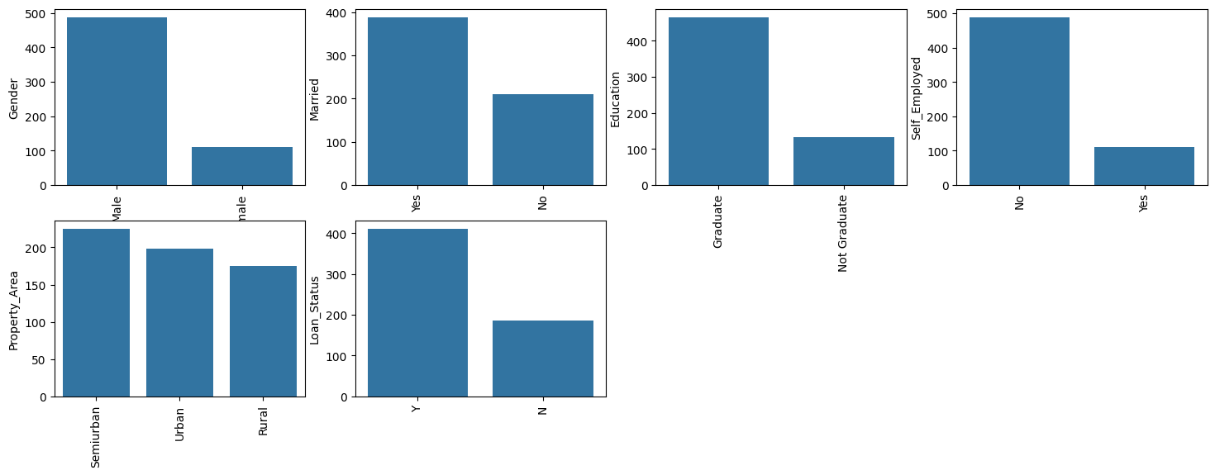
Colab Link

Slide 8
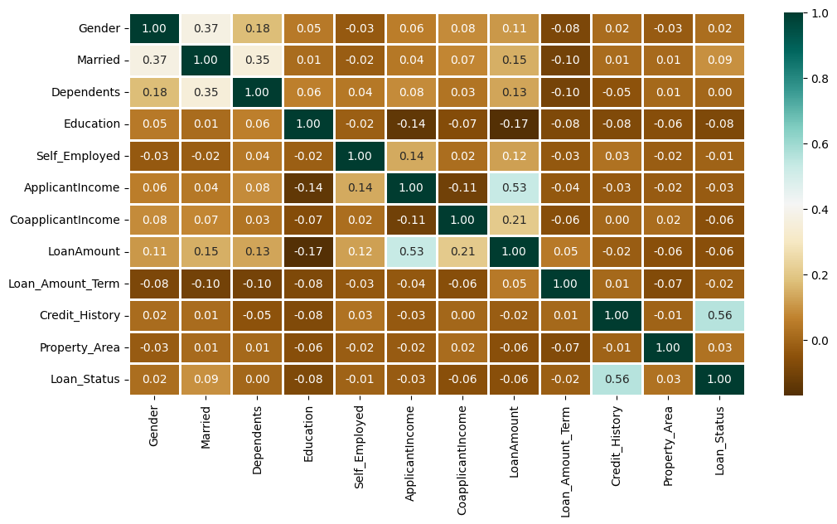

Slide 9
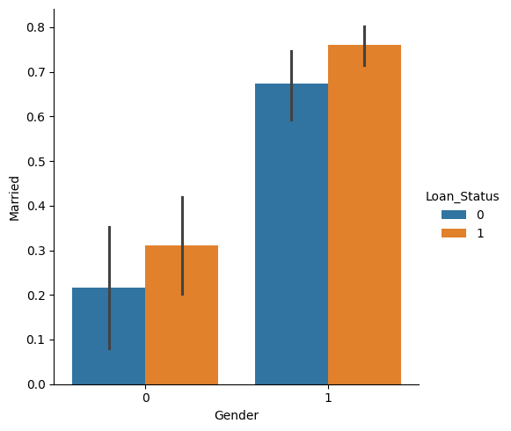

Slide 10
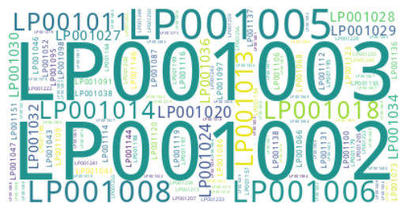
Word cloud visualization for Loan ID

Slide 11
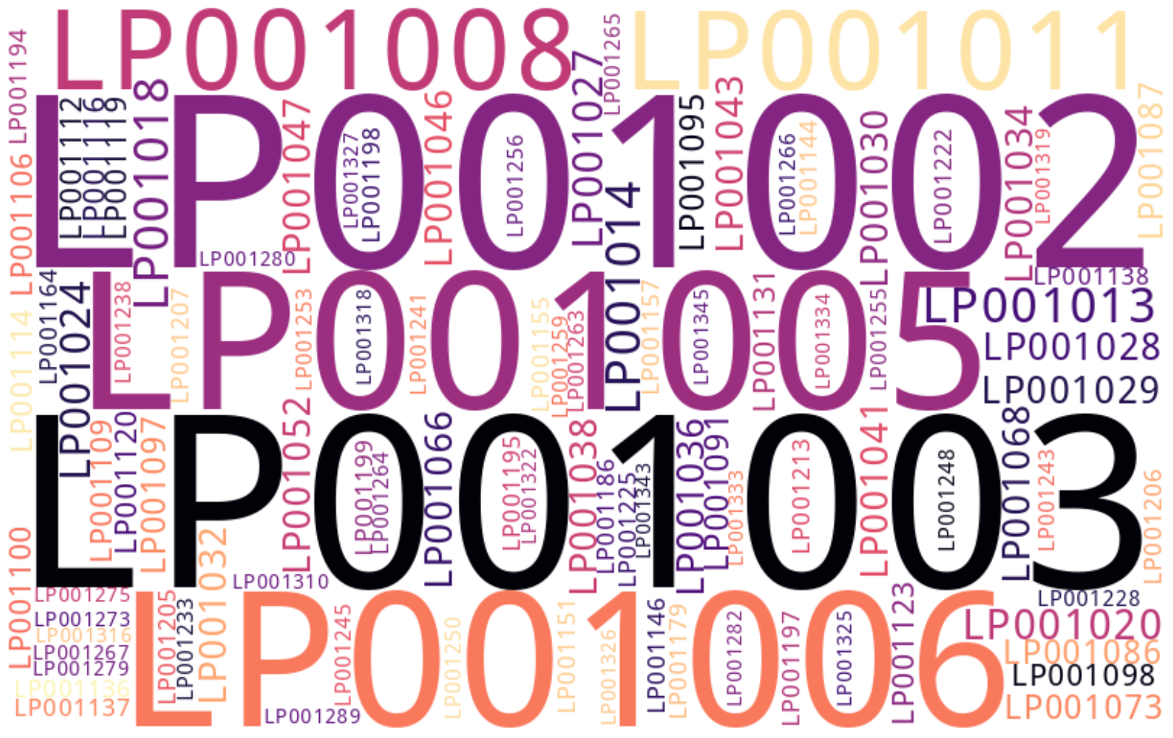

Slide 12
THANK YOU
Pramodh 20201ISE0053
Purvika S 20201ISE0050
Chatur S 20201ISE0094

